Slide 1
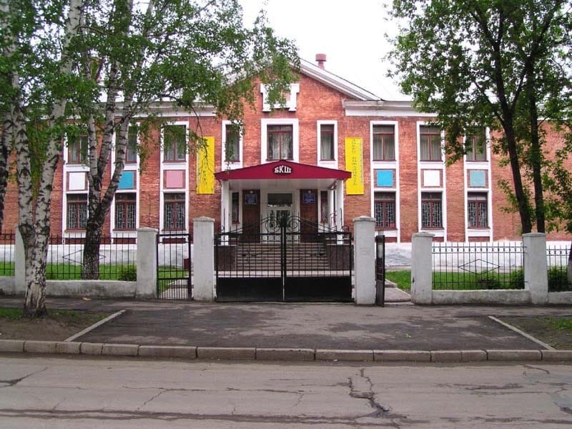
LIFE IN BCS
Are you aged 14 to 17?
Why do not you spend a year in Russia and have experience of life in Russian high school? We invite you to our school.

Slide 2
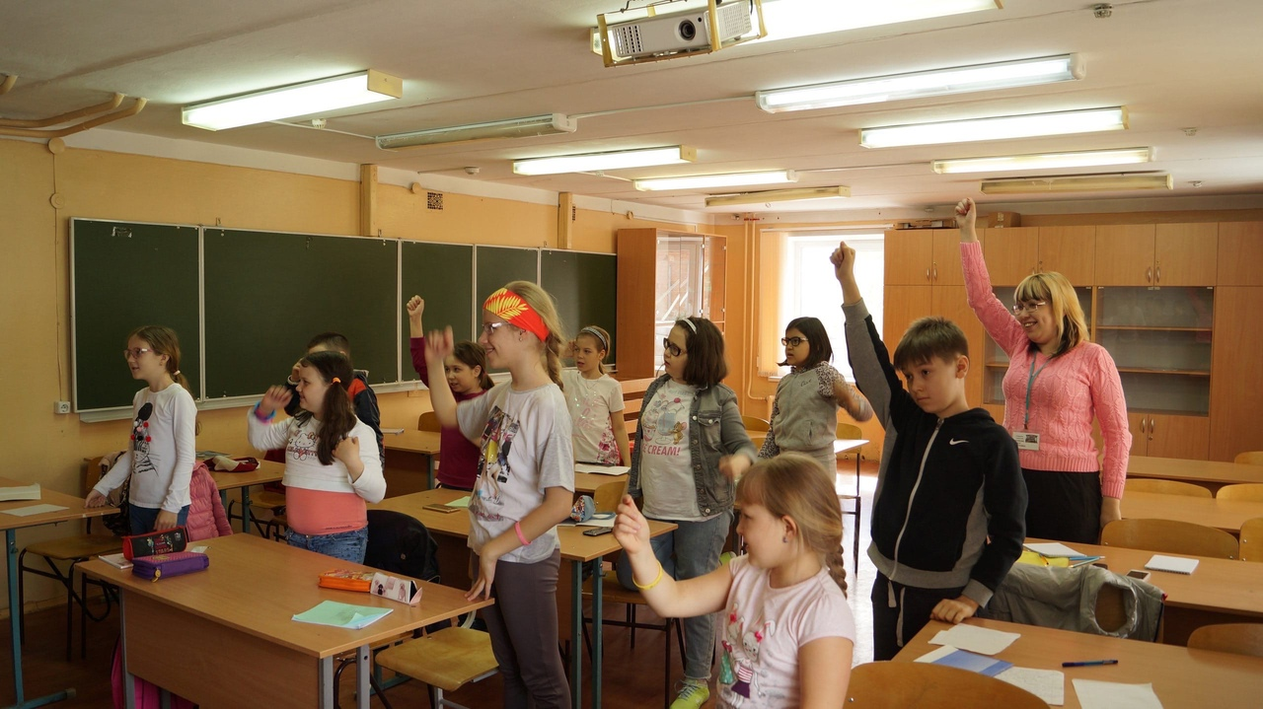
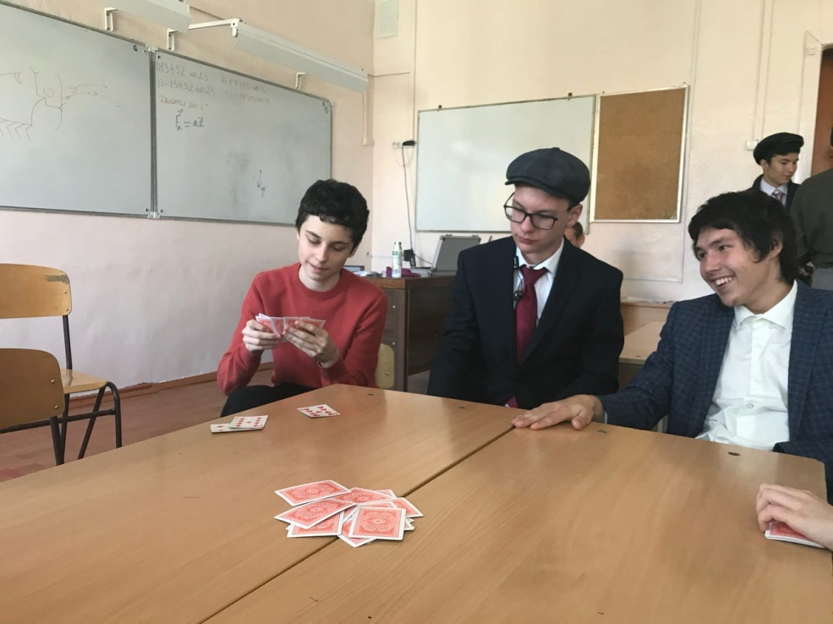
Subjects
BCS encourages students to think independently and give a lot of interesting knowledge. Our school offers a great range of subjects. We study math, history, biology, geography and other amazing subjects with good teachers who teaches us in relaxed and informal style.

Slide 3
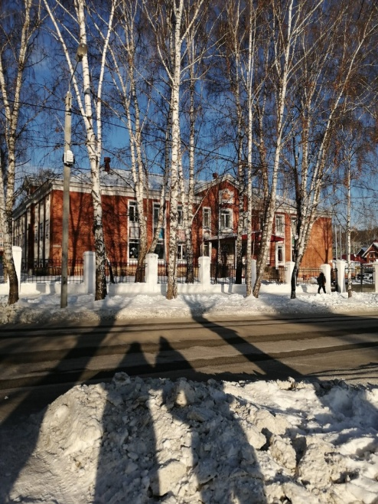
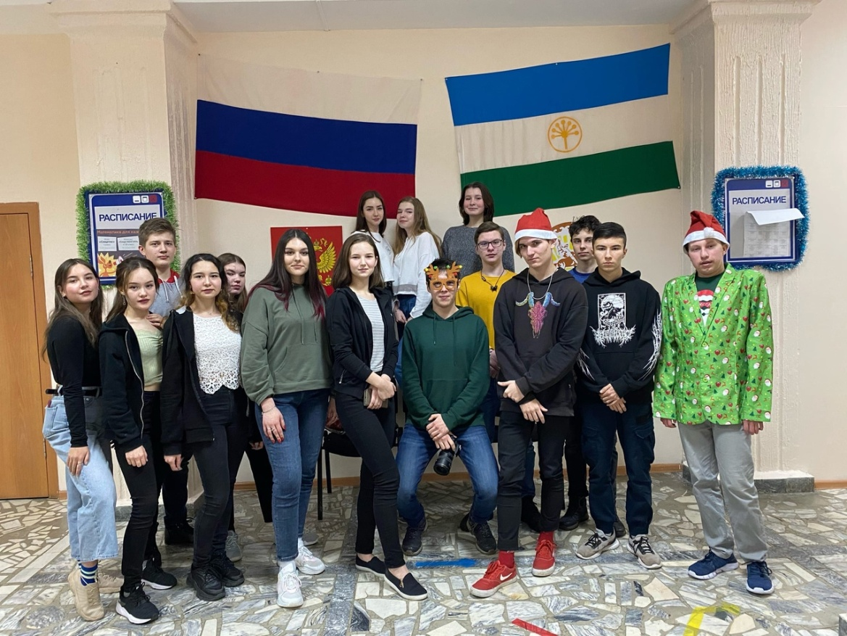
School life
If you participate in our program, you will have an interesting learning experience. Pupils walk or drive to school, then go to their locker to take off their outerwear. You will then have 5-6 hours of basic classes with a lunch break. After that, you go home, and later come back for additional classes, which last 2 hours.
You can get grades by answering questions in class or doing homework. Exams are waiting for you, at the end of each year, and in the last year of study, you take the final exam to enter the university and get a report card. In total, school takes 11 years.

Slide 4
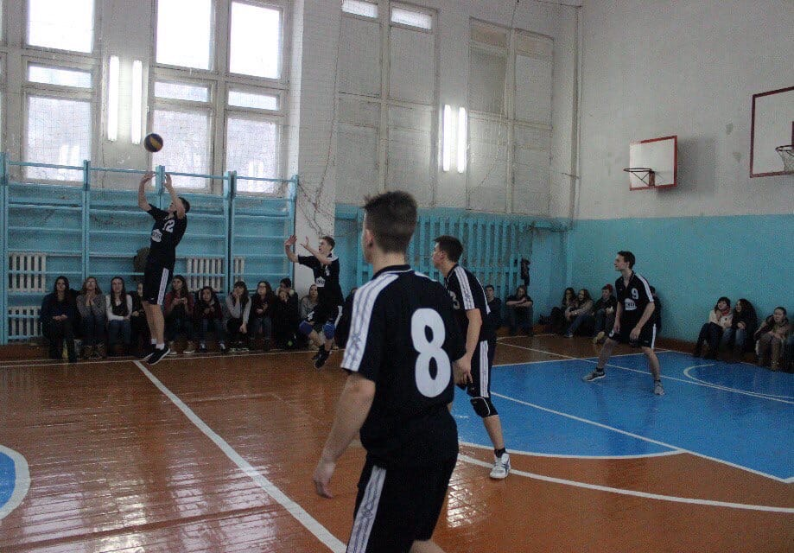
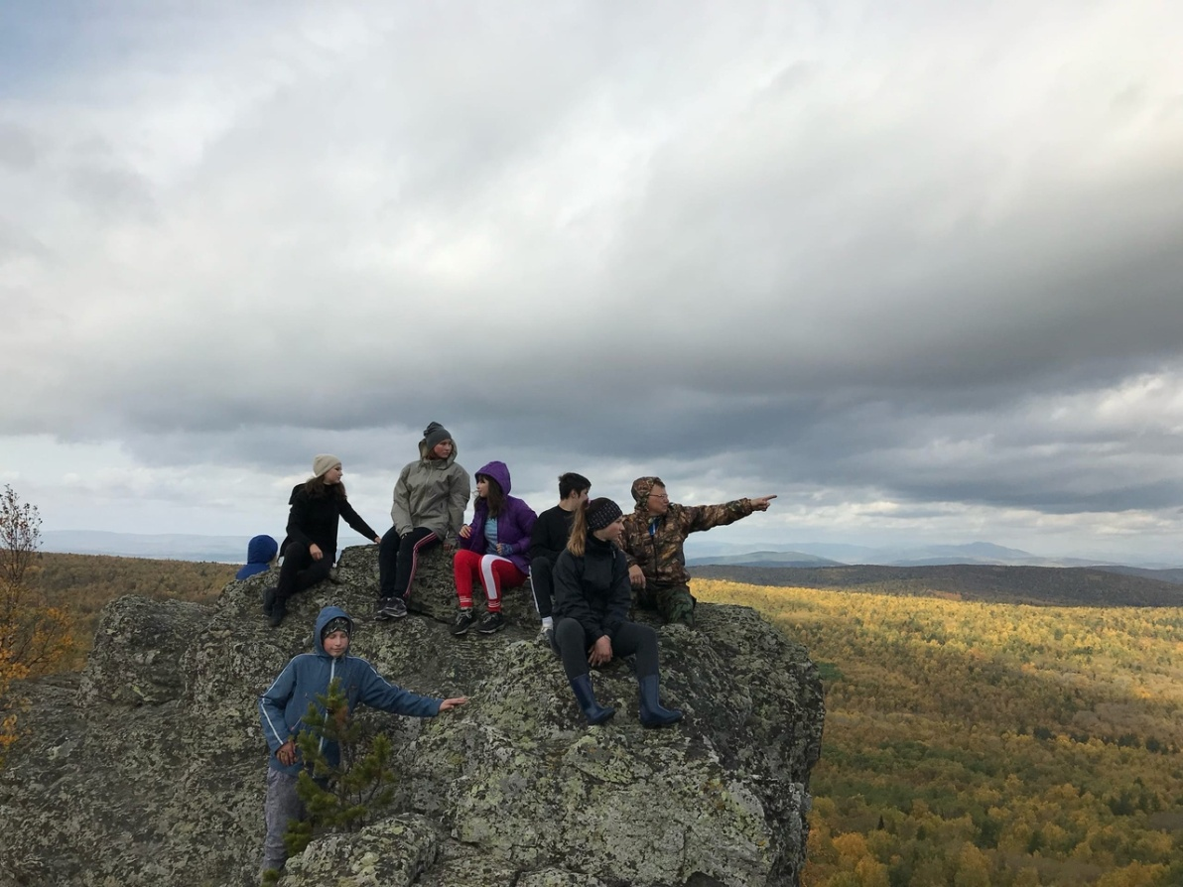
Sports and extra-curricular activities
For middle and high school students, our school has two sports sections. The first is volleyball, the second is basketball. All students in the school can participate in these sports sections.
Both volleyball and basketball practice twice a week. Also, at school events, all classes put on dances. Sometimes we go hiking in classes to a variety of interesting places. When hiking, we can see the most picturesque locations.

Slide 5

We invite you to our school! We’re sure it will be unforgettable and amazing adventure for you!

